Slide 1

Data Analysis with R Programming
Deepankar Sharma

Slide 2

Course Outcomes
In this course, you’ll learn about the programming language known as R. You’ll find out how to use RStudio, the environment that allows you to work with R. This course will also cover the software applications and tools that are unique to R, such as R packages.

Slide 3
Data Analysis
Data analysis is the process of cleaning, changing, and processing raw data and extracting actionable, relevant information that helps businesses make informed decisions.

Slide 4
Programming with R
R is a programming language that can help you in your data analysis process.
RStudio is the environment you’ll use to work in R.
Using R can help you complete your analysis efficiently and effectively.
The R programming language was designed to work with data at all stages of the data analysis process.

Slide 5
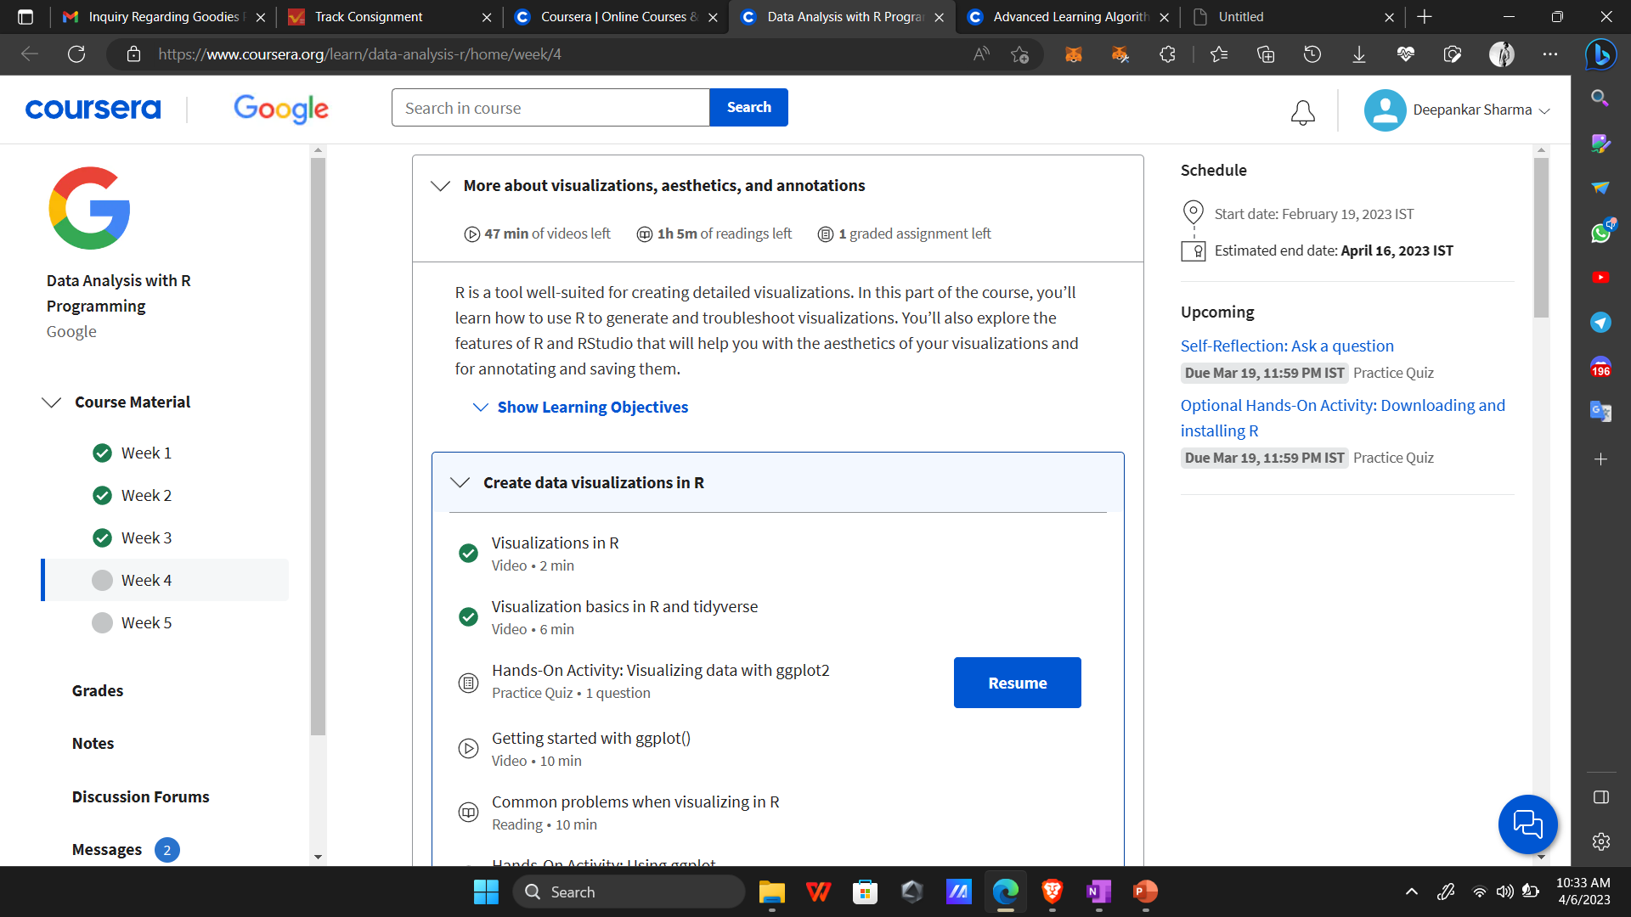
Current Progress

Slide 6
Thank You !!!

